Slide 1

P_update
Format: b0 v0 chi_max
Need to see collapse of dilute layer to get sharp decrease

Slide 2




Corrected
Previous

Slide 3

Incorrect

Slide 4

Corrected - 20220722

Slide 5
Fine adjust

Slide 6












b1.0 v0.51 c6
b1.0 v0.52 c6
b=1.0, v=0.50, chi = 2.4, 2.6, 2.8

Slide 7







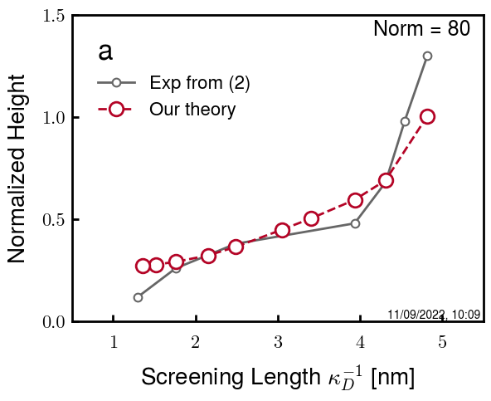
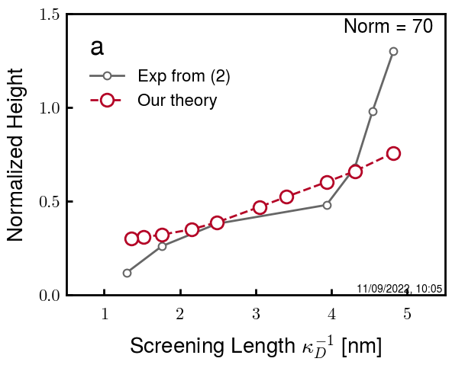
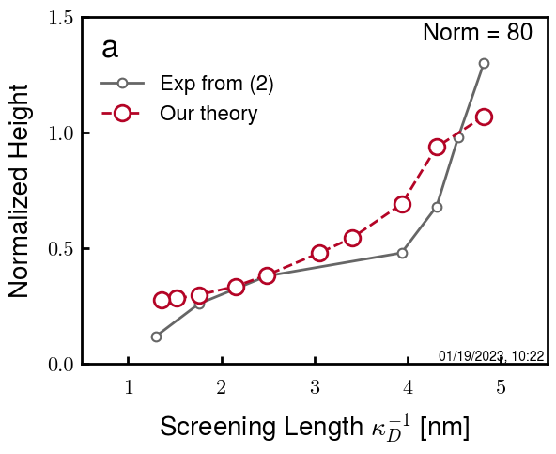
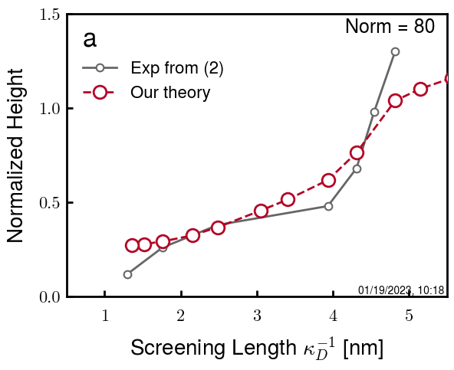
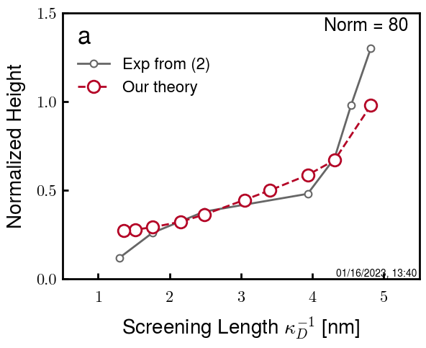
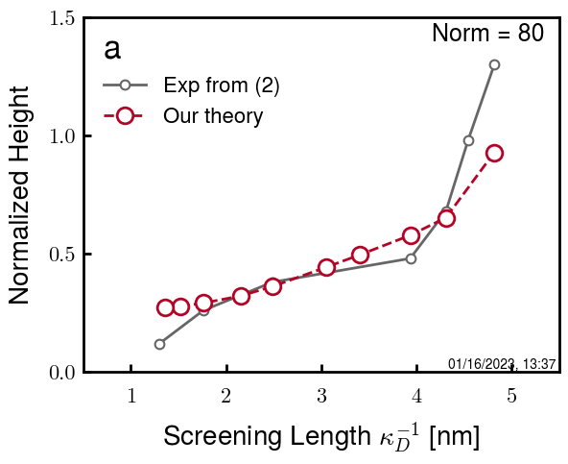
b=2.0, v=1.20, chi = 2.4, 2.6, 2.8
b2.0 v1.20 c8
b2.0 v1.21 c8
b2.1 v1.20 c8
b2.2 v1.22 c8
b2.2 v1.22 c0
b2.2 v1.22 c1
b2.2 v1.22 c2
b2.2 v1.20 c3.05
b2.2 v1.20 c1
b2.2 v1.22 c1
b2.2 v1.23 c1
b2.2 v1.24 c1

Slide 8
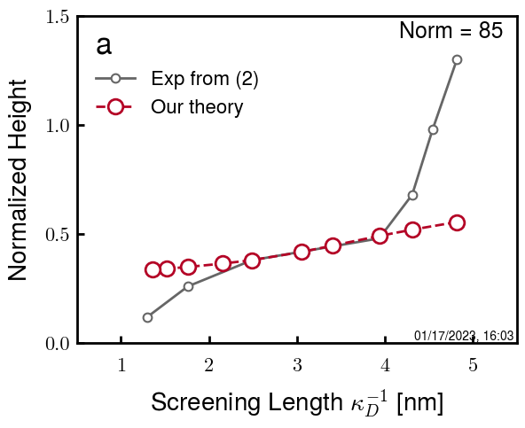
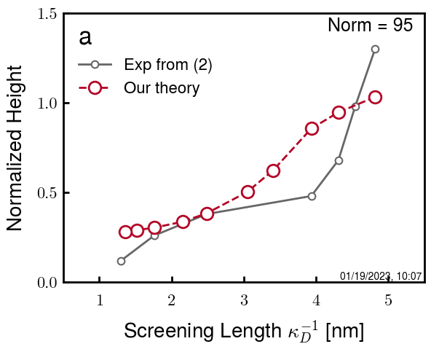

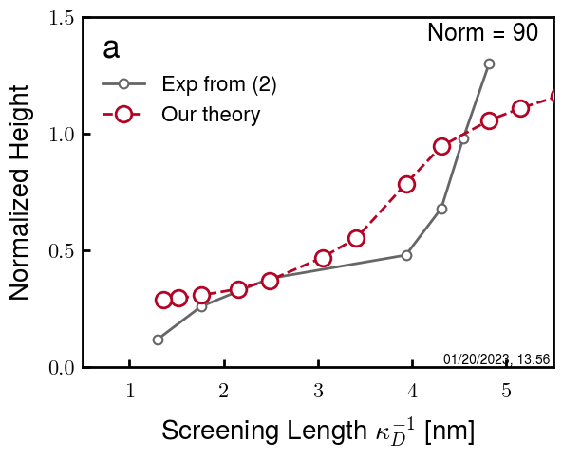
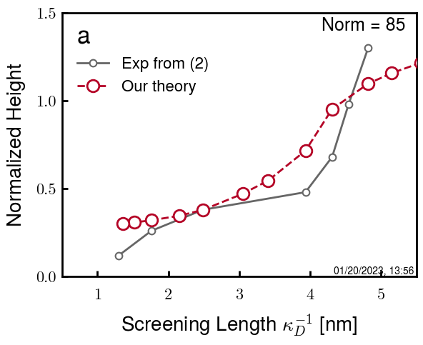
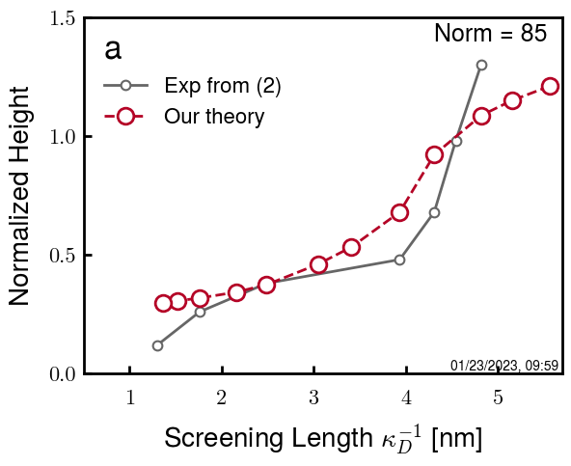
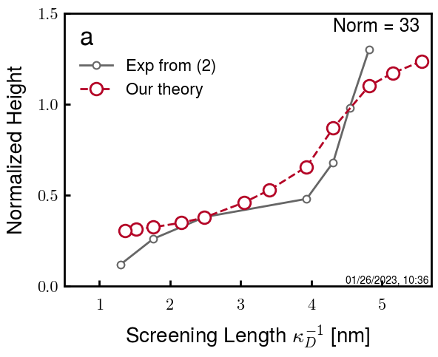

b2.5 v1.25 c3.10
b2.5 v1.25 c3.15
b2.5 v1.25 c3.20
b2.5 v1.25 c3.25 (f255)
b2.5 v1.25 c3.30 (f253)
b2.5 v1.25 c3.32 (f332)
b2.5 v1.25 c3.35 (f335)
b2.5 v1.25 c3.40 (f340)
WIP 3-10

Slide 9
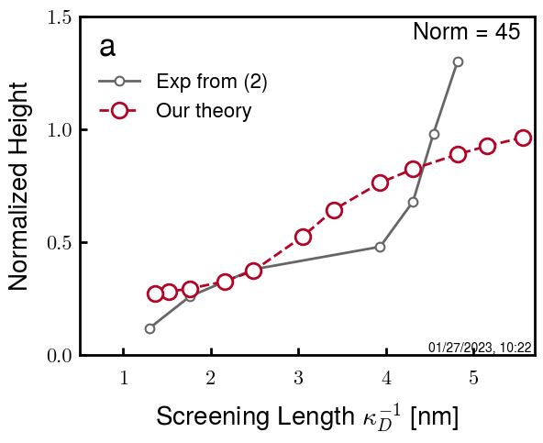
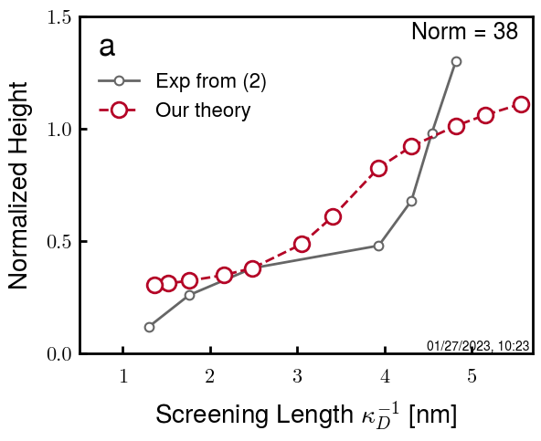
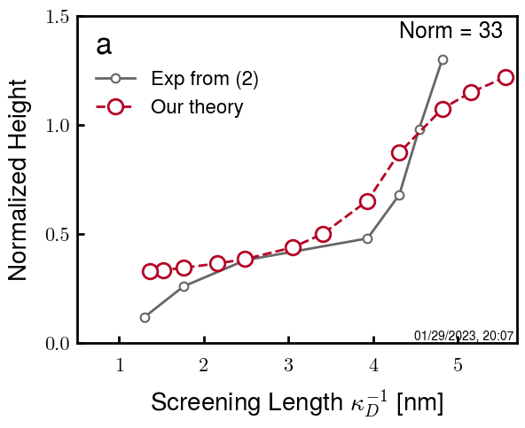
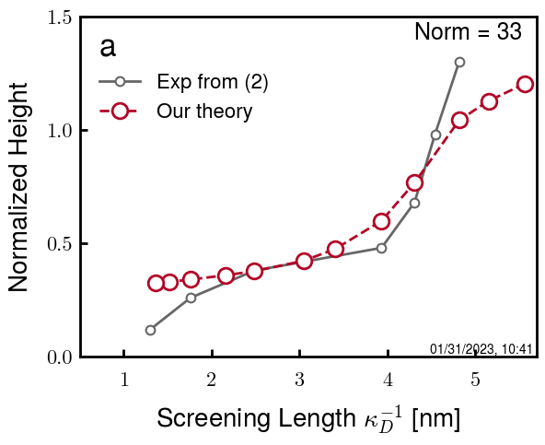
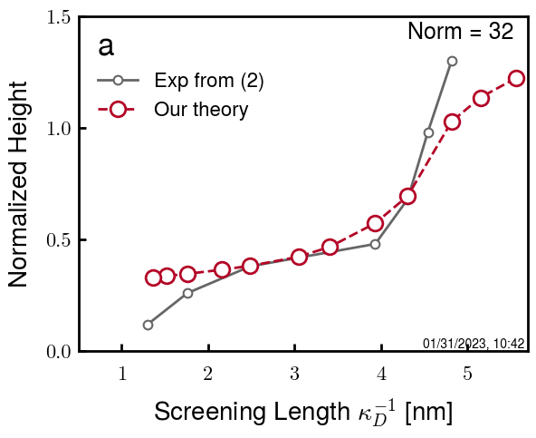
b3.0 v1.30 c3.45
b3.0 v1.30 c3.65
b3.0 v1.30 c3.90
b3.0 v1.30 c3.95
b3.0 v1.30 4.00

Slide 10
Summary

Slide 11
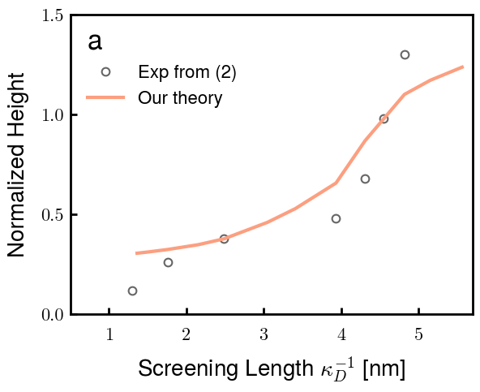
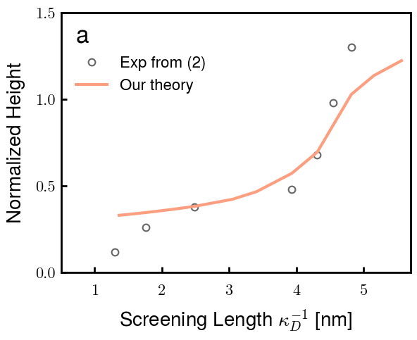
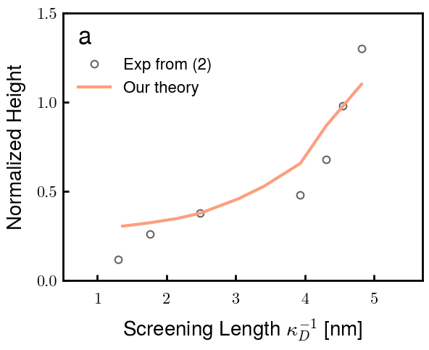
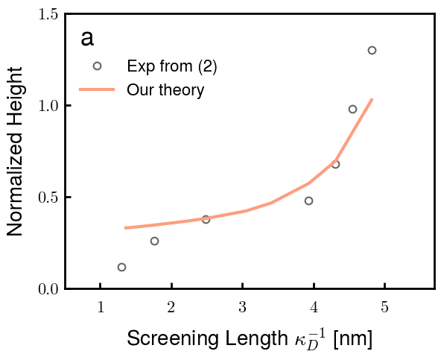
b2.5 v1.25 c3.40 (f340)
b3.0 v1.30 4.00 (f400)

Slide 12
Interacting
NFH on both plates with decreasing centerline distance D

Slide 13
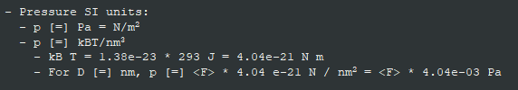
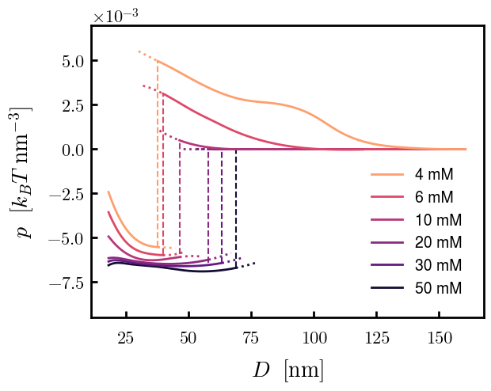
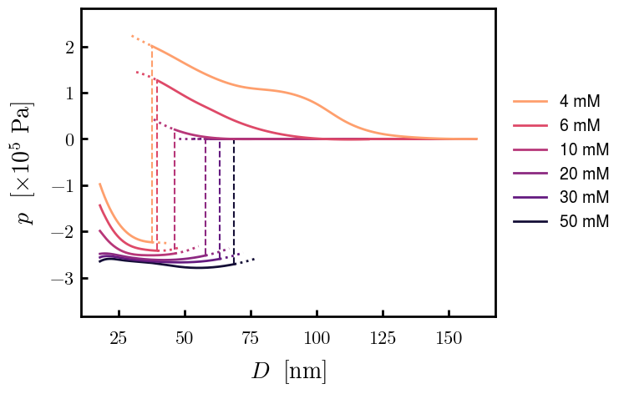

Slide 14
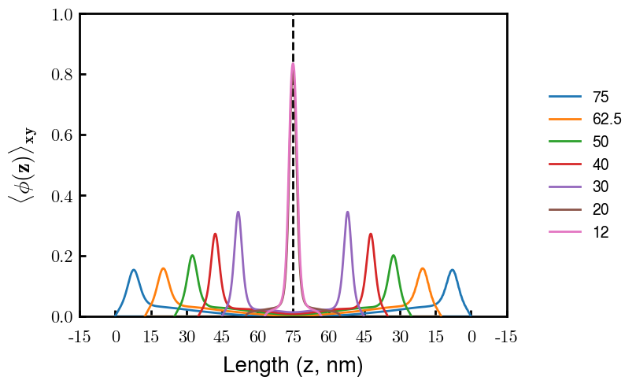
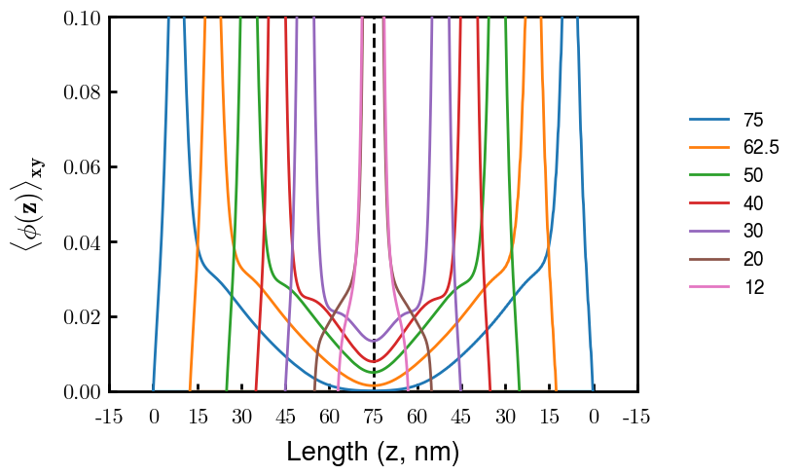
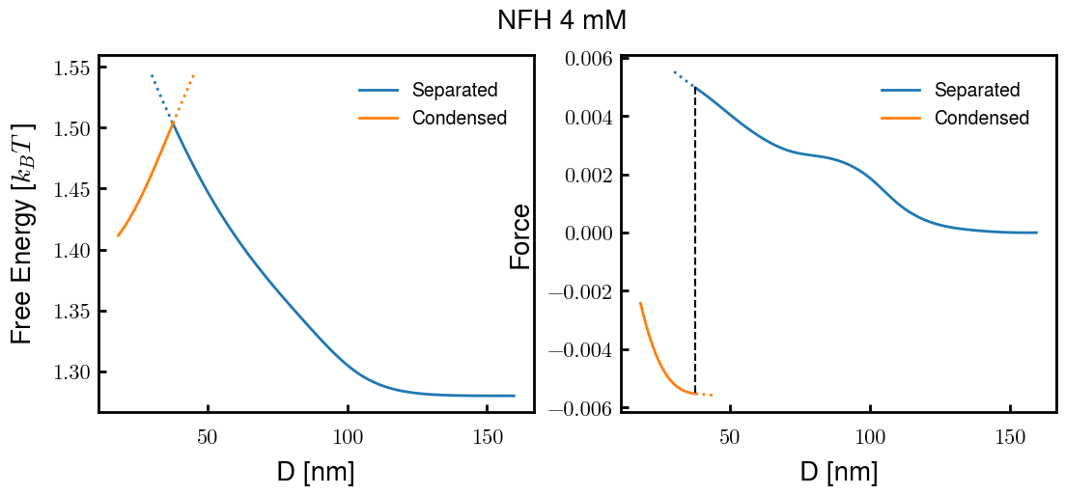
Cs = 4mM
x 2

Slide 15
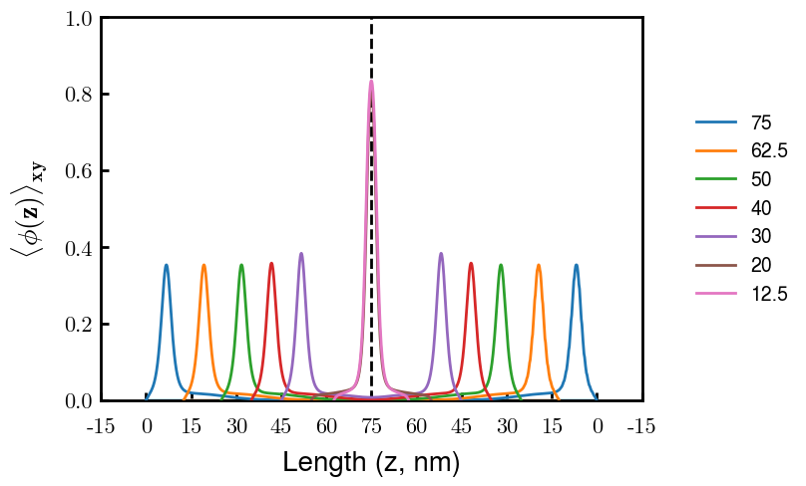
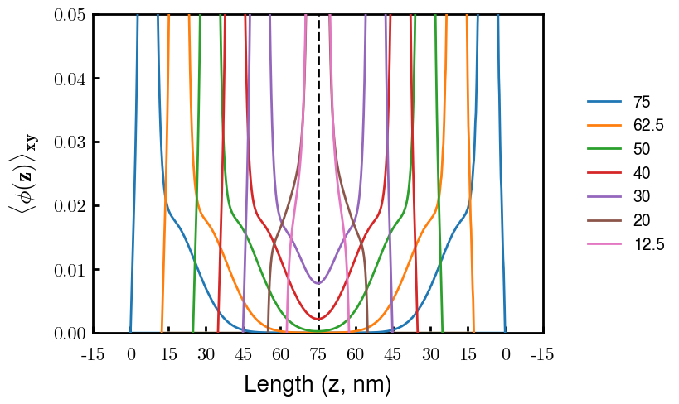
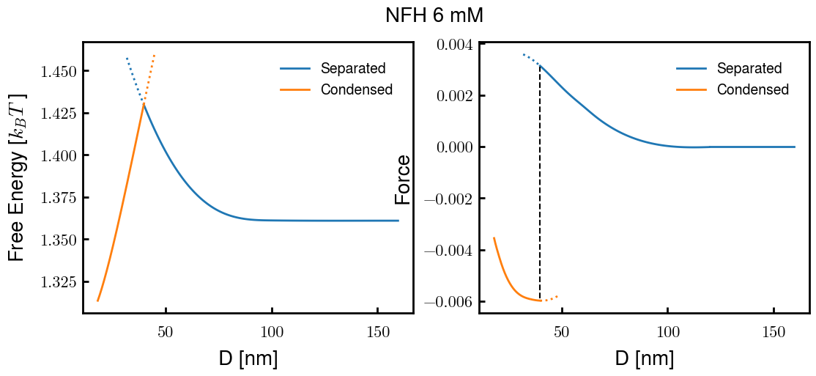
Cs = 6mM

Slide 16
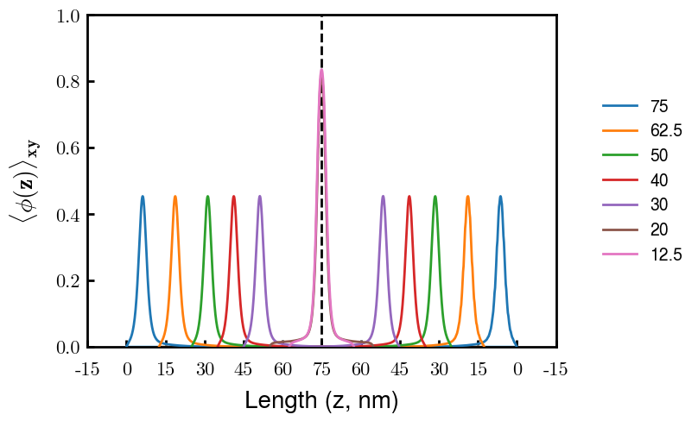
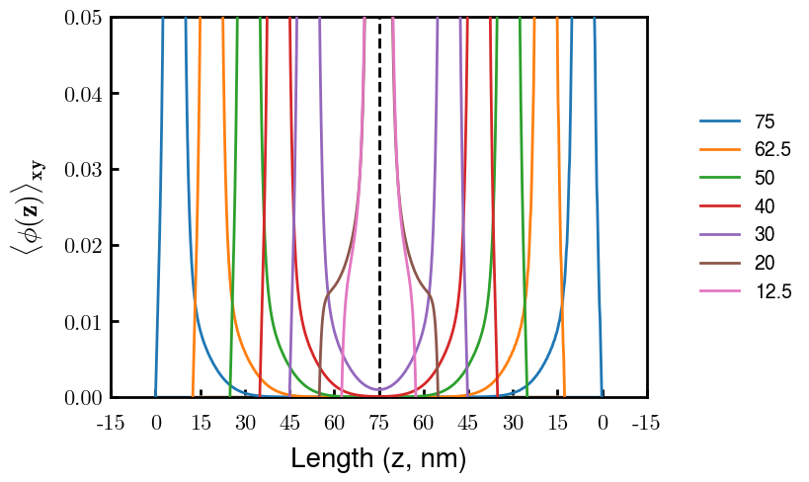
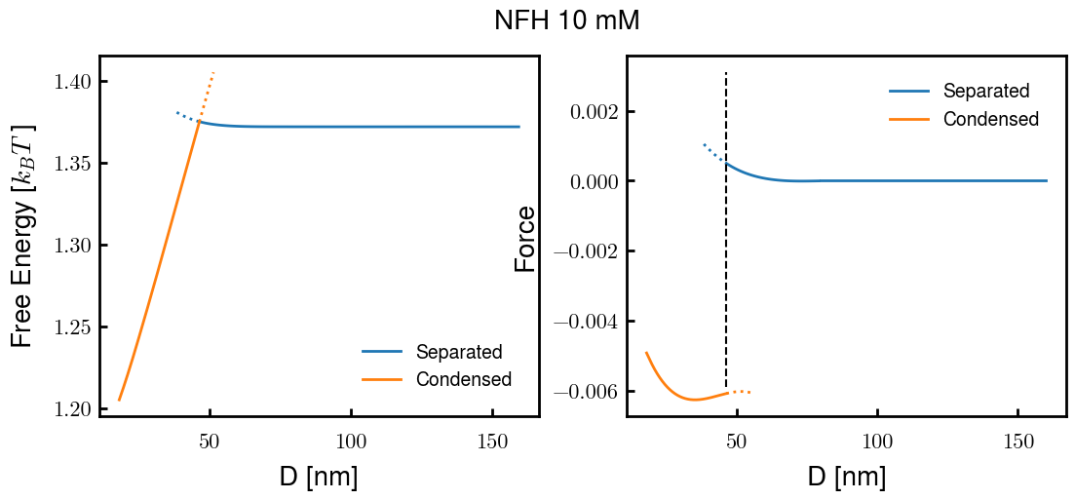
Cs = 10mM

Slide 17
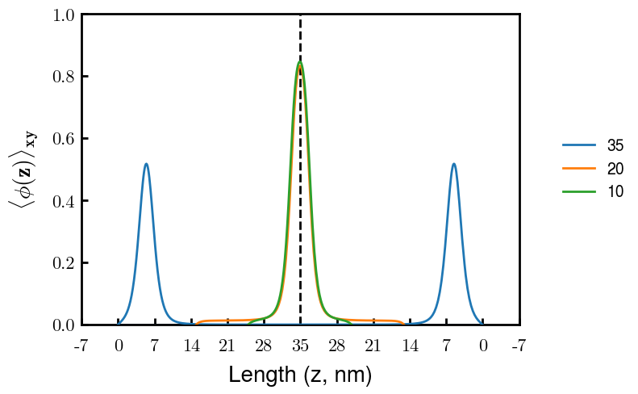
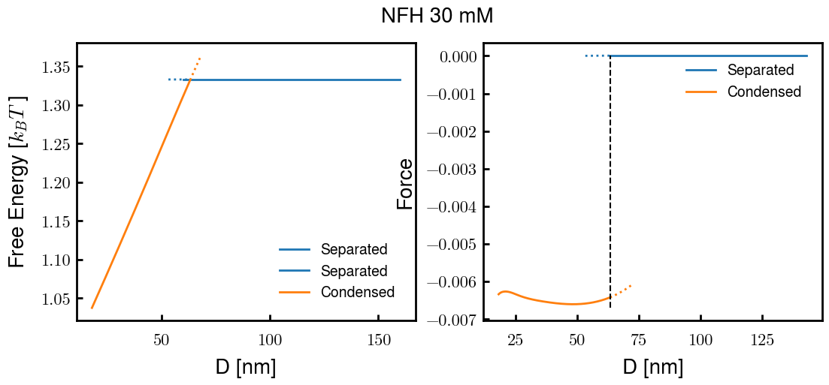
Cs = 30mM

Slide 18
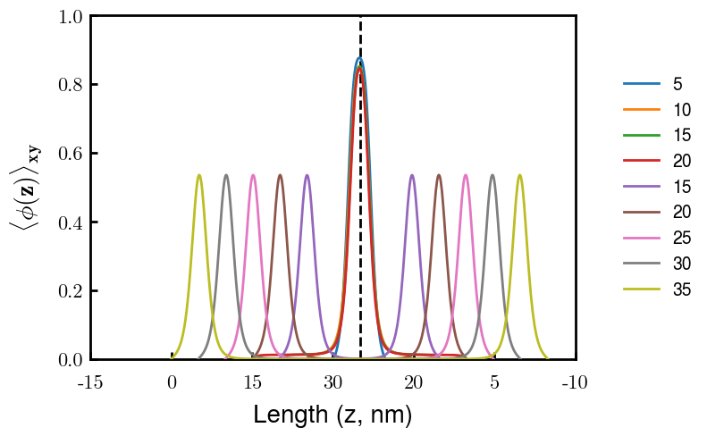
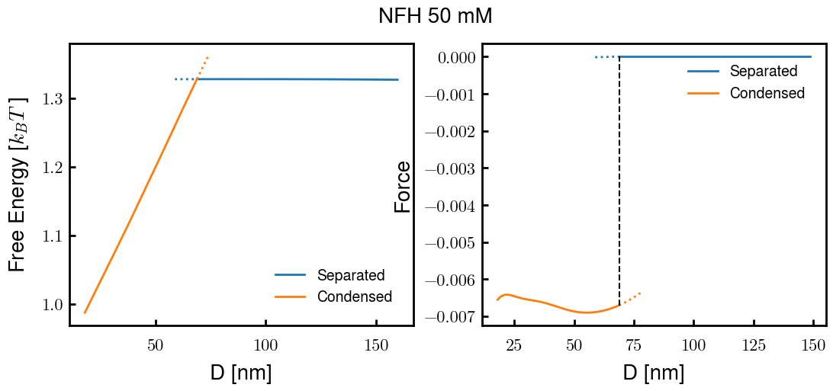
Cs = 50mM

Slide 19
Initial sweep
b10, b15, b20; chi 2.6
v0 = x b^3 (b/d ratio)

Slide 20

Using excluded volume from Rubinstein Ch 3.1
Start with b = 0.5, 1.0, 1.5, 2.0, 5.0 nm
V0 = b^3 (spherical) (max flexible)
b^2 * d (cylindrical)
New options (09/03 code)
V0 = 4/3*pi*b^3 (b/d = 0.2387…) (Max flexible)
V1 = 1.00*b^3 (b/d = 1.0)
V2 = 0.50*b^3 (b/d = 2.0) (Rubinstein “flexible”)
V3 = 0.33*b^3 (b/d = 3.0) (Rubinstein “flexible”)
V4 = 0.15*b^3 (b/d = 6.5)
Rubinstein, pdf pg 108: b/d 2~3 for flexible,
PE, PEO: d = 0.8 nm
PS: d = 0.5 nm

Slide 21





b10 – thresh = 1e-04

Slide 22




b10 – maxpoint Gibbs

Slide 23




b10 – first moment Gibbs

Slide 24





b10

Slide 25





B15 – thresh = 1e-04

Slide 26





b15 - maxpt

Slide 27





b15 - norm

Slide 28





b15

Slide 29





b20 – thresh = 1e-04

Slide 30





b20 - maxpt

Slide 31




b20 - norm

Slide 32





b20

Slide 33
V perturb
Around b10 v2 and b20 v4 (~%20)

Slide 34






-20%: v=0.4
Orig: b=1.0, v=0.5
+20%: v=0.6

Slide 35



-20%: v=0.4
Orig: b=1.0, v=0.5
+20%: v=0.6

Slide 36






-20%: v=1.0
Orig: b=2.0, v=1.2
+20%: v=1.4

Slide 37


-20%: v=1.0
Orig: b=2.0, v=1.2
+20%: v=1.4

Slide 38
Chi perturb
Around b10 v2 and b20 v4 (~%20)

Slide 39





c4
Orig: b=1.0, v=0.5, chi = 2.6
c8
c0

Slide 40



c4
Orig: b=1.0, v=0.5, chi = 2.6
c8
c0

Slide 41







c4
Orig: b=2.0, v=1.2, chi = 2.6
c8
c0

Slide 42



c4
Orig: b=2.0, v=1.2, chi = 2.6
c8
c0

Slide 43
PREV

Slide 44






06 04 260
06 04 240
06 04 220
07 04 260
07 04 240
07 04 220

Slide 45






08 04 260
08 04 240
08 04 220
09 04 260
09 04 240
09 04 220

Slide 46
10 04 260
10 04 240
10 04 220
All stretched longer than given box size (150*0.6 = 90)

Slide 47






04 03 260
04 03 240
04 03 220
05 03 260
05 03 240
05 03 220

Slide 48






06 03 260
06 03 240
06 03 220
07 03 260
07 03 240
07 03 220

Slide 49





04 05 260
04 05 240
04 05 220
05 05 260
05 05 240
05 05 220

Slide 50






06 05 260
06 05 240
06 05 220
07 05 260
07 05 240
07 05 220

Slide 51




04 06 260
04 06 240
04 06 220
05 06 260
05 06 240
05 06 220

Slide 52






06 06 260
06 06 240
06 06 220
07 06 260
07 06 240
07 06 220

Slide 53



05 07 260
05 07 240
05 07 220
06 07 260
06 07 240
06 07 220

Slide 54



07 07 260
07 07 240
07 07 220
08 07 260
08 07 240
08 07 220

Slide 55
06 09 260
06 09 240
06 09 220
07 09 260
07 09 240
07 09 220

Slide 56





08 09 260
08 09 240
08 09 220
09 09 260
09 09 240
09 09 220

Slide 57



10 09 260
10 09 240
10 09 220

Slide 58






1.0 1.0 2.6
1.0 1.0 2.8
1.0 1.0 3.0
1.2 1.0 2.6
1.2 1.0 2.8
1.2 1.0 3.0

Slide 59




1.4 1.0 2.6
1.4 1.0 2.8
1.4 1.0 3.0
1.0 1.2 2.6
1.0 1.2 2.8
1.0 1.2 3.0

Slide 60




1.2 1.2 2.6
1.2 1.2 2.8
1.2 1.2 3.0
1.4 1.2 2.6
1.4 1.2 2.8
1.4 1.2 3.0

Slide 61






1.0 1.4 2.6
1.0 1.4 2.8
1.0 1.4 3.0
1.2 1.4 2.6
1.2 1.4 2.8
1.2 1.4 3.0

